Slide 1



Ethics in IT
Class VIII
lab 5

Slide 2

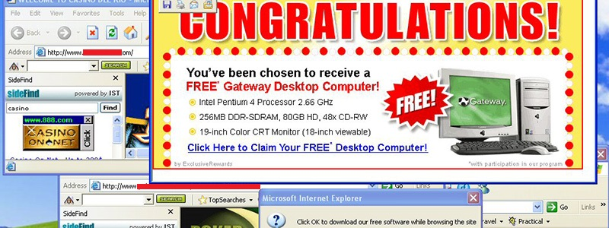
Adware
Adware is software designed to force pre-chosen ads to display on your system

Slide 3

Attack
An attack is an action that is done on a system to get its access and extract sensitive data

Slide 4
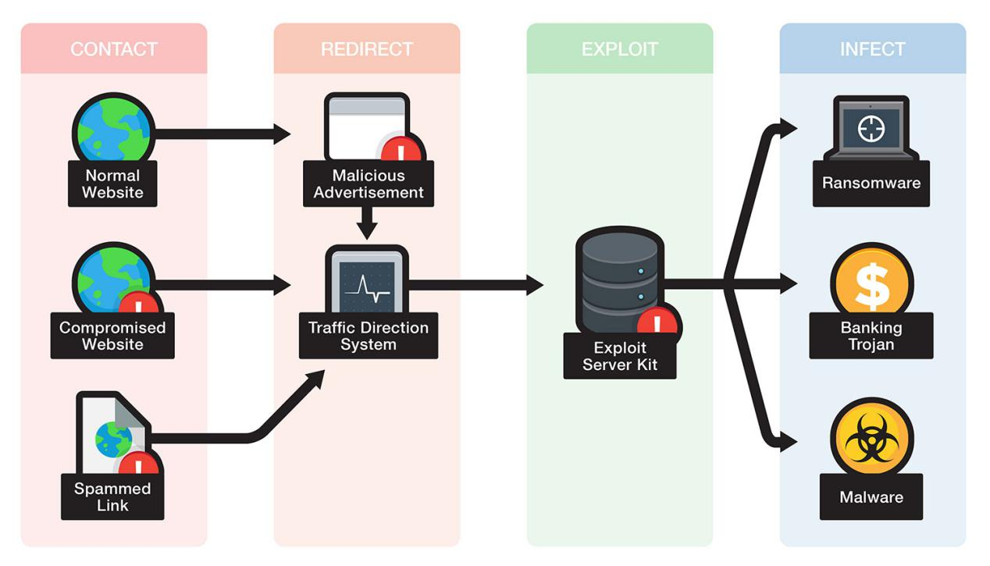
Exploit Kit
An exploit kit is software system designed to run on web servers, with the purpose of identifying software vulnerabilities

Slide 5
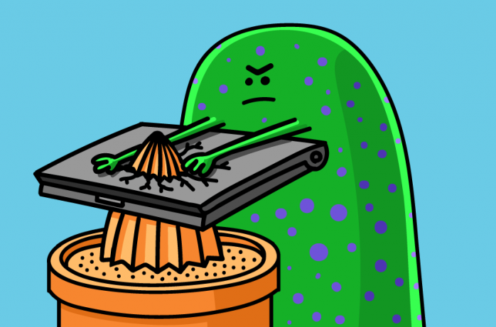
Exploit
Exploit is a piece of software that takes advantage of a bug or vulnerability to compromise the security of a computer

Slide 6
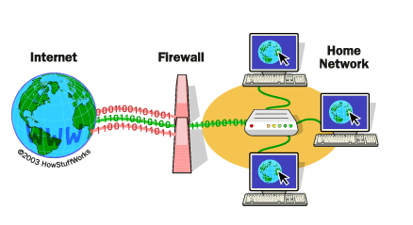
Firewall
A firewall is a filter designed to keep unwanted intruders outside a computer system

Slide 7

Logic bomb
A virus secreted into a system that triggers a malicious action when certain conditions are met

Slide 8

Phishing
Phishing is an e-mail fraud method to gather personal and financial information from recipients.

Slide 9

SQL Injection
SQL injection is an SQL code injection technique, used to attack data-driven applications

Slide 10



